Slide 1

Jason, Addis, Zach, Connor

Slide 2

Our Goals
Design a flight plan generator that is…
Comprehensive
Detail-Oriented
3-Dimensional
Versatile
On the market today:
Simple
2-Dimensional
Standard

Slide 3
Applications
Film/Photography
Construction
3D Modeling
Surveillance
Modern new perspective
And…

Slide 4
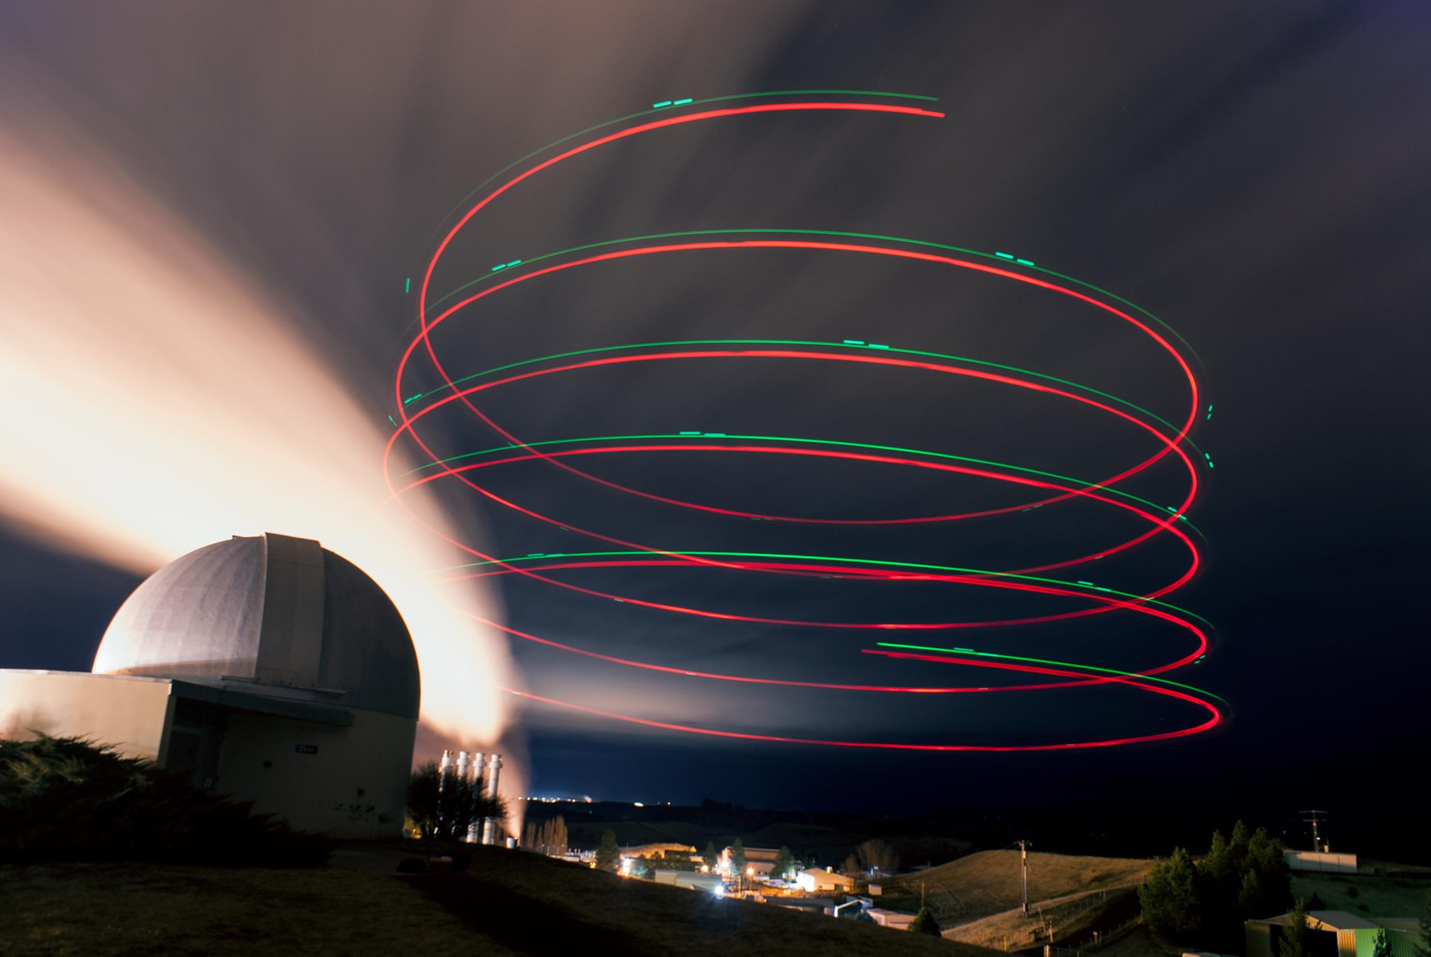
Drone Shows!

Slide 5
Future Goals
Synchronization
Collaboration
Interface improvements
VR support

Slide 6
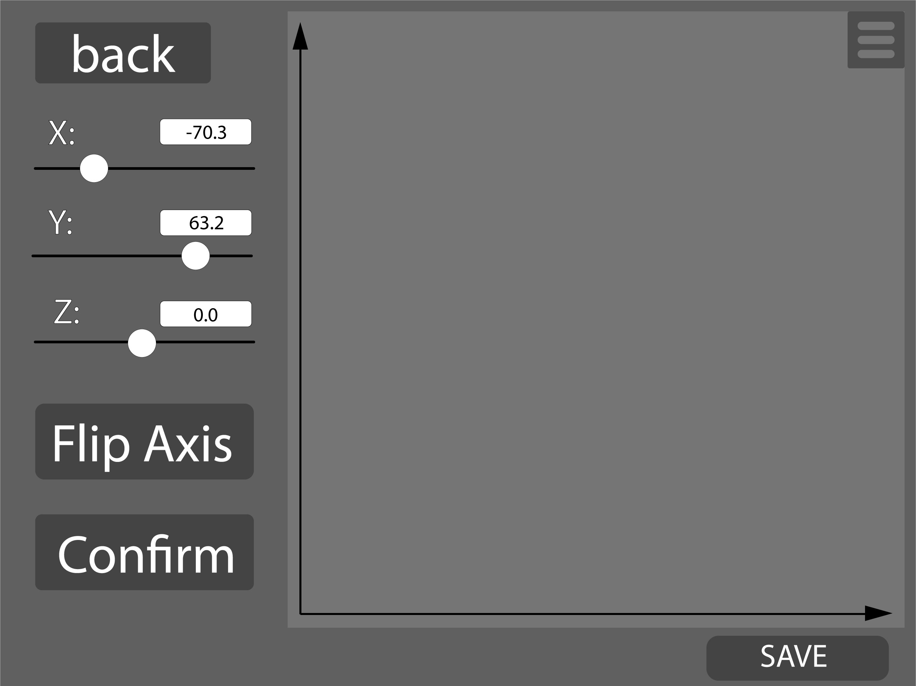
Editing
3D Editing on 2D plane
Control over every aspect
Ability to edit/delete points
Automatic line connection

Slide 7
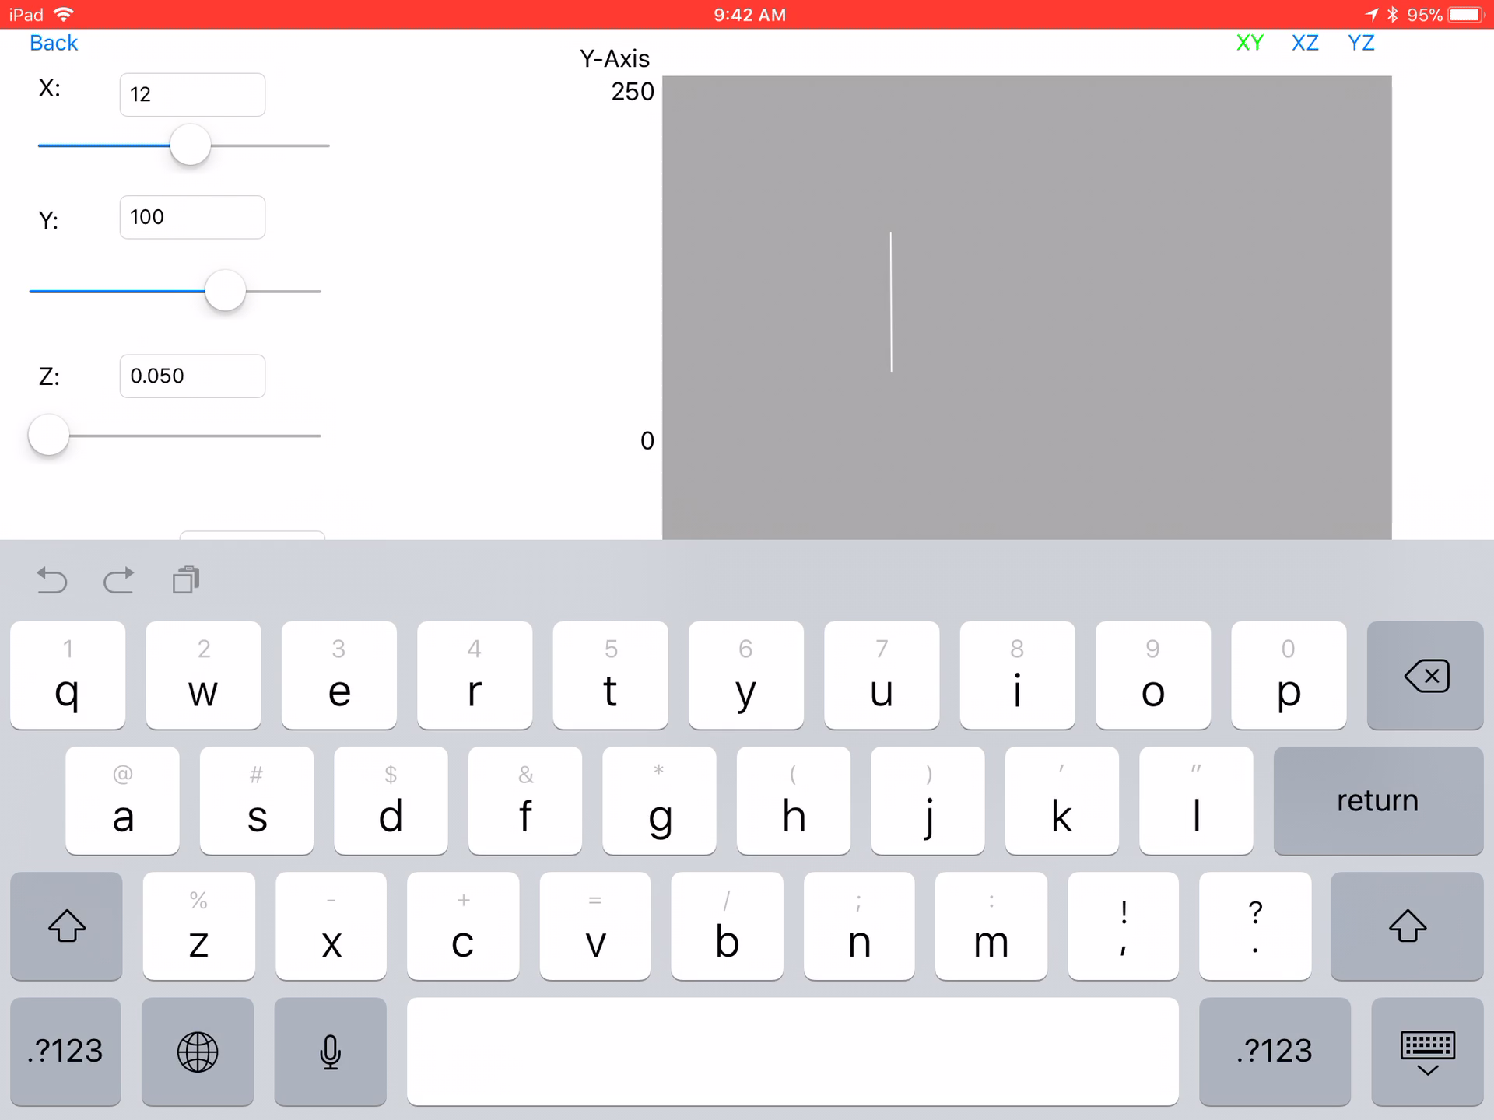
Demo

Slide 8
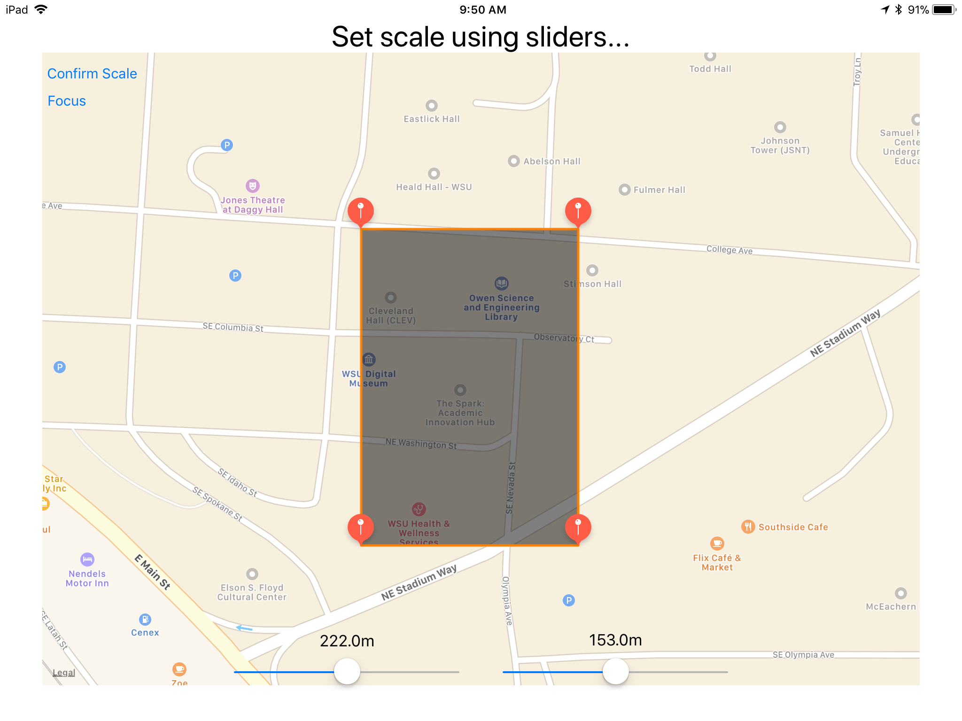
Map View
Flight plan positioning
Custom scaling
See current location

Slide 9
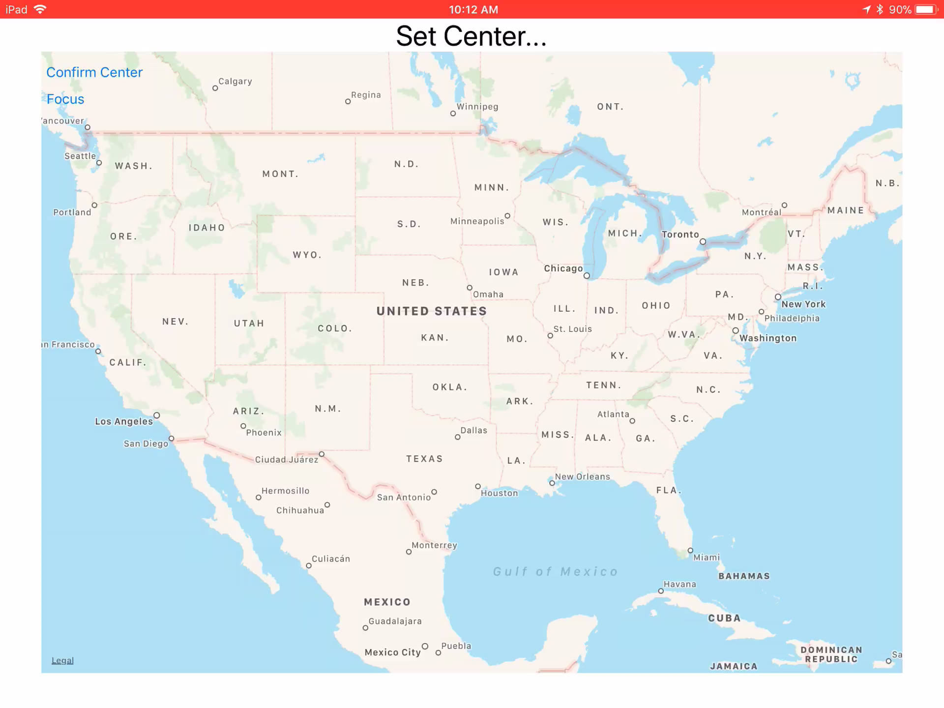
Demo

Slide 10
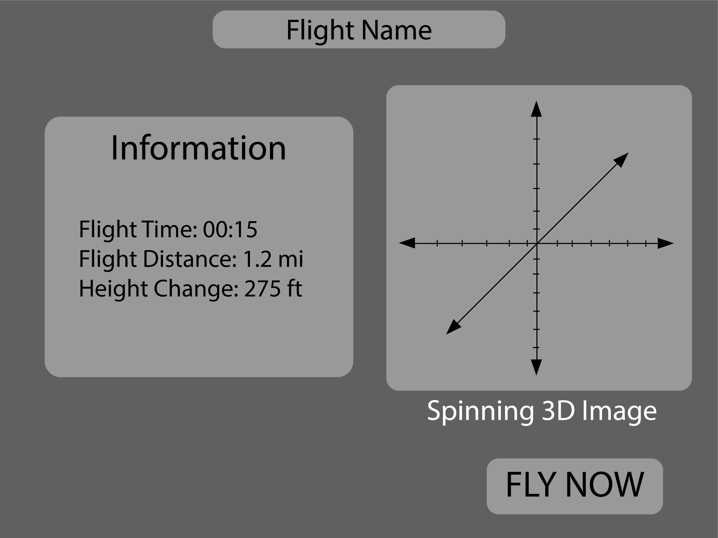
Confirmation
Waypoint mission generation
Time and distance calculations
Plot summaries
Future: 3D model of designed flight plan

